Slide 1

PDS API (version alpha)
Thomas Loubrieu, Jordan Padams, Dan Crichton, Emily Law, Steve Hughes
Jet Propulsion Laboratory, California Institute of Technology
OpenPlanetary Virtual Lunch Talk
April 5, 2021
© 2021 California Institute of Technology.
Government sponsorship acknowledged.

Slide 2
Overview
PDS Data Services Background
What can an API do or me?
PDS API Working Group
PDS API Specification and Implementation
Coming Soon…
PDS API Demo with Jupyter Notebooks

Slide 3
PDS Data Services Vision (2019) [2] [3]
Provide an integrated worldwide data services platform that enables the efficient discovery, dissemination, use and analysis of internationally sponsored planetary science archives.
[2] Abstract: https://www.hou.usra.edu/meetings/planetdata2019/pdf/7105.pdf
[3] Poster: https://www.hou.usra.edu/meetings/planetdata2019/eposter/7105.pdf

Slide 4
PDS Data Services Vision (2019) [2] [3]
We accomplish this by:
Capturing and curating archival data and metadata to enable both discovery and use by the community
Providing a worldwide planetary science data portal as a gateway to archival data and services across PDS, IPDA and the broad planetary science community
Providing consistent APIs for sharing archival data and services across PDS, among planetary archives, and within the planetary science community
Supporting a federated cross-node, cross-agency search that enables users to get as close to the archived data and services as possible
Enabling the ongoing exploration and integration of modern tools and access methods to enable data discovery and analysis from visualization to mining of archival data
[2] Abstract: https://www.hou.usra.edu/meetings/planetdata2019/pdf/7105.pdf
[3] Poster: https://www.hou.usra.edu/meetings/planetdata2019/eposter/7105.pdf

Slide 5
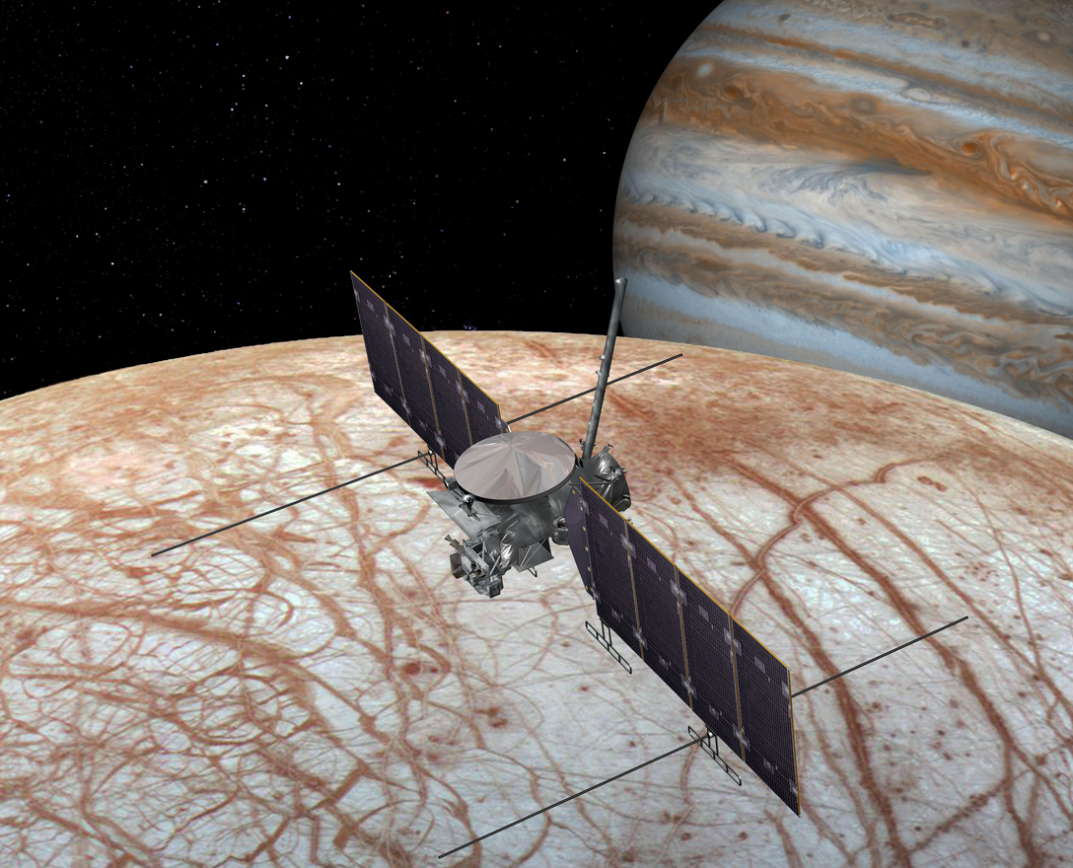
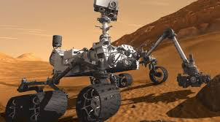
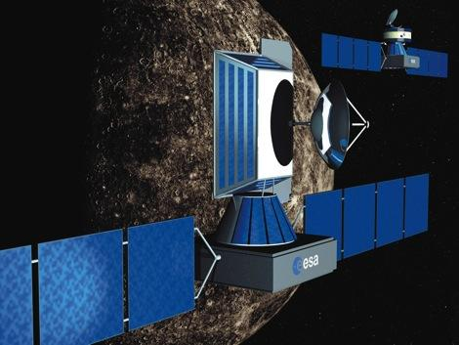
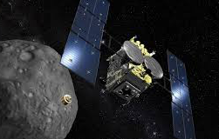
Towards a Planetary Data Ecosystem
PDS
Engineering
High Level Search; Content Products
Search
Services (1,2,9)
Data Access Portals
Data Access Portals
Data Access Portals
PDS
Archive
PDS
Archive
Access
Services (3)
PDS
Archive
Product Level Search
3. Retrieve Product by LIDVID
PDS Node
Archive
Transformation
Services (4)
Visualization
High Level Search
Product Level
Retrieve Product
Visualization
PSA
Archive
Visualization (7)
On-demand
Algorithms
(6,8)
High Level Search
Product Level
Retrieve Product
JAXA
Archive
Data Analysis Tools
Data Analysis Tools
Computational
Services (6)
Data Analysis Tools (5)
Stewardship Services
User Services
Community

Slide 6
Data Services Evolution
Analysis Support and Analytics
Visualization and analysis tools
Integrated data analysis notebooks
PDS4 extensions for dynamic labeling
5+ years
Search and Access
PDS4 extensions for Common and Discipline Queries
Common APIs
Search Engine Integration
Web UI/UX for PDS4
2-5 years
Stewardship
PDS4 Information Model
Tools for Data Delivery and Stewardship
Command and Discipline Search Tools
Today

Slide 7
Data Services Evolution
Analysis Support and Analytics
Visualization and analysis tools
Integrated data analysis notebooks
PDS4 extensions for dynamic labeling
5+ years
Search and Access
PDS4 extensions for Common and Discipline Queries
Common APIs
Search Engine Integration
Web UI/UX for PDS4
2-5 years
Stewardship
PDS4 Information Model
Tools for Data Delivery and Stewardship
Command and Discipline Search Tools
Today

Slide 8


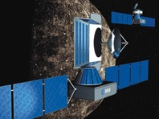
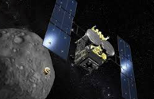
PDS Data Services Initiative
PDS
Engineering
High Level Search; Content Products
Search
Services (1,2,9)
Data Access Portals
Data Access Portals
Data Access Portals
PDS
Archive
PDS
Archive
Access
Services (3)
PDS
Archive
Product Level Search
3. Retrieve Product by LIDVID
PDS Node
Archive
Transformation
Services (4)
Visualization
High Level Search
Product Level
Retrieve Product
Visualization
PSA
Archive
Visualization (7)
On-demand
Algorithms
(6,8)
High Level Search
Product Level
Retrieve Product
JAXA
Archive
Data Analysis Tools
Data Analysis Tools
Computational
Services (6)
Data Analysis Tools (5)
Stewardship Services
User Services
Community

Slide 9
PDS Data Services Initiative
PDS
Engineering
High Level Search; Content Products
Search
Services (1,2,9)
Data Access Portals
Data Access Portals
Data Access Portals
PDS
Archive
PDS
Archive
Access
Services (3)
PDS
Archive
Product Level Search
3. Retrieve Product by LIDVID
PDS Node
Archive
Stewardship
is our continued focus as an archive
(PDS4)
Transformation
Services (4)
Visualization
High Level Search
Product Level
Retrieve Product
Visualization
PSA
Archive
Visualization (7)
On-demand
Algorithms
(6,8)
High Level Search
Product Level
Retrieve Product
JAXA
Archive
Data Analysis Tools
Data Analysis Tools
Computational
Services (6)
Data Analysis Tools (5)
Stewardship Services
User Services
Community

Slide 10
PDS Data Services Initiative
PDS
Engineering
High Level Search; Content Products
Search
Services (1,2,9)
Data Access Portals
Data Access Portals
Data Access Portals
PDS
Archive
PDS
Archive
Access
Services (3)
PDS
Archive
Product Level Search
3. Retrieve Product by LIDVID
PDS Node
Archive
But, we need to improve discoverability, accessibility, and usability
of the archives
Transformation
Services (4)
Visualization
High Level Search
Product Level
Retrieve Product
Visualization
PSA
Archive
Visualization (7)
On-demand
Algorithms
(6,8)
High Level Search
Product Level
Retrieve Product
JAXA
Archive
Data Analysis Tools
Data Analysis Tools
Computational
Services (6)
Data Analysis Tools (5)
Stewardship Services
User Services
Community

Slide 11
PDS Data Services Initiative
PDS
Engineering
High Level Search; Content Products
Search
Services (1,2,9)
Data Access Portals
Data Access Portals
Data Access Portals
PDS
Archive
PDS
Archive
To enable
the PDS and community to develop tools to enhance the usability the data
PDS
Archive
Product Level Search
3. Retrieve Product by LIDVID
Access
Services (3)
PDS Node
Archive
Transformation
Services (4)
Visualization
High Level Search
Product Level
Retrieve Product
Visualization
PSA
Archive
Visualization (7)
On-demand
Algorithms
(6,8)
High Level Search
Product Level
Retrieve Product
JAXA
Archive
Data Analysis Tools
Data Analysis Tools
Computational
Services (6)
Data Analysis Tools (5)
Stewardship Services
User Services
Community

Slide 12
PDS Data Services Initiative
PDS
Engineering
High Level Search; Content Products
Search
Services (1,2,9)
Data Access Portals
Data Access Portals
Data Access Portals
PDS
Archive
PDS
Archive
Access
Services (3)
PDS
Archive
Product Level Search
3. Retrieve Product by LIDVID
PDS Node
Archive
Transformation
Services (4)
Visualization
High Level Search
Product Level
Retrieve Product
Visualization
PSA
Archive
Visualization (7)
On-demand
Algorithms
(6,8)
First, we need well-documented, well understood interfaces (aka search APIs) and services for searching and accessing archival data.
High Level Search
Product Level
Retrieve Product
JAXA
Archive
Data Analysis Tools
Data Analysis Tools
Computational
Services (6)
Data Analysis Tools (5)
Stewardship Services
User Services

Slide 13
PDS Data Services Initiative
Then we move onto tools and services that support analysis, analytics, and usability we know our community desperately needs.
PDS
Engineering
High Level Search; Content Products
Search
Services (1,2,9)
Data Access Portals
Data Access Portals
Data Access Portals
PDS
Archive
PDS
Archive
Access
Services (3)
PDS
Archive
Product Level Search
3. Retrieve Product by LIDVID
PDS Node
Archive
Transformation
Services (4)
Visualization
High Level Search
Product Level
Retrieve Product
Visualization
PSA
Archive
Visualization (7)
On-demand
Algorithms
(6,8)
High Level Search
Product Level
Retrieve Product
JAXA
Archive
Data Analysis Tools
c
Data Analysis Tools
Computational
Services (6)
Data Analysis Tools (5)
Stewardship Services
User Services

Slide 14
What can an API do for me?
Notes:
Group to drive the development of the specification

Slide 15
APIs Provide the Highways to
Drive Users to The Data
Including the exits, traffic, clunkers clogging up the roads, speed traps, etc.
Notes:
Group to drive the development of the specification

Slide 16
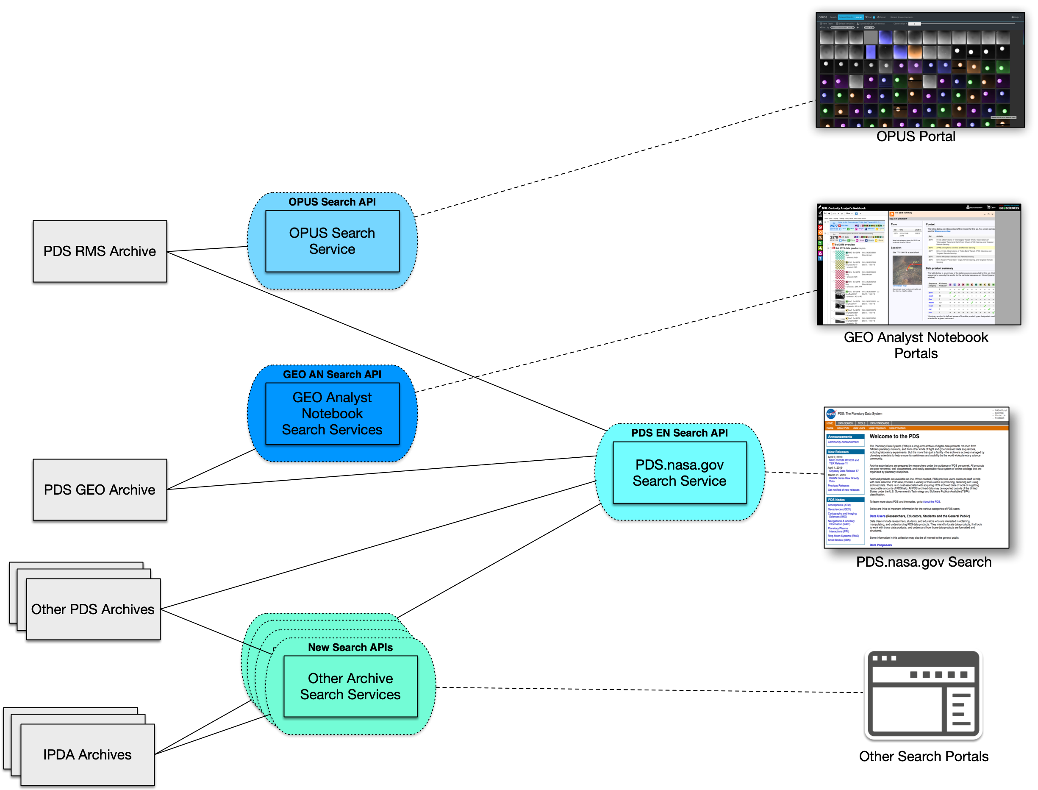
Current State Of Search Integration

Slide 17
Current State Of Search Integration
Many different roads and paths (APIs),
some paved with clear signs,
some backcountry dirt roads...

Slide 18
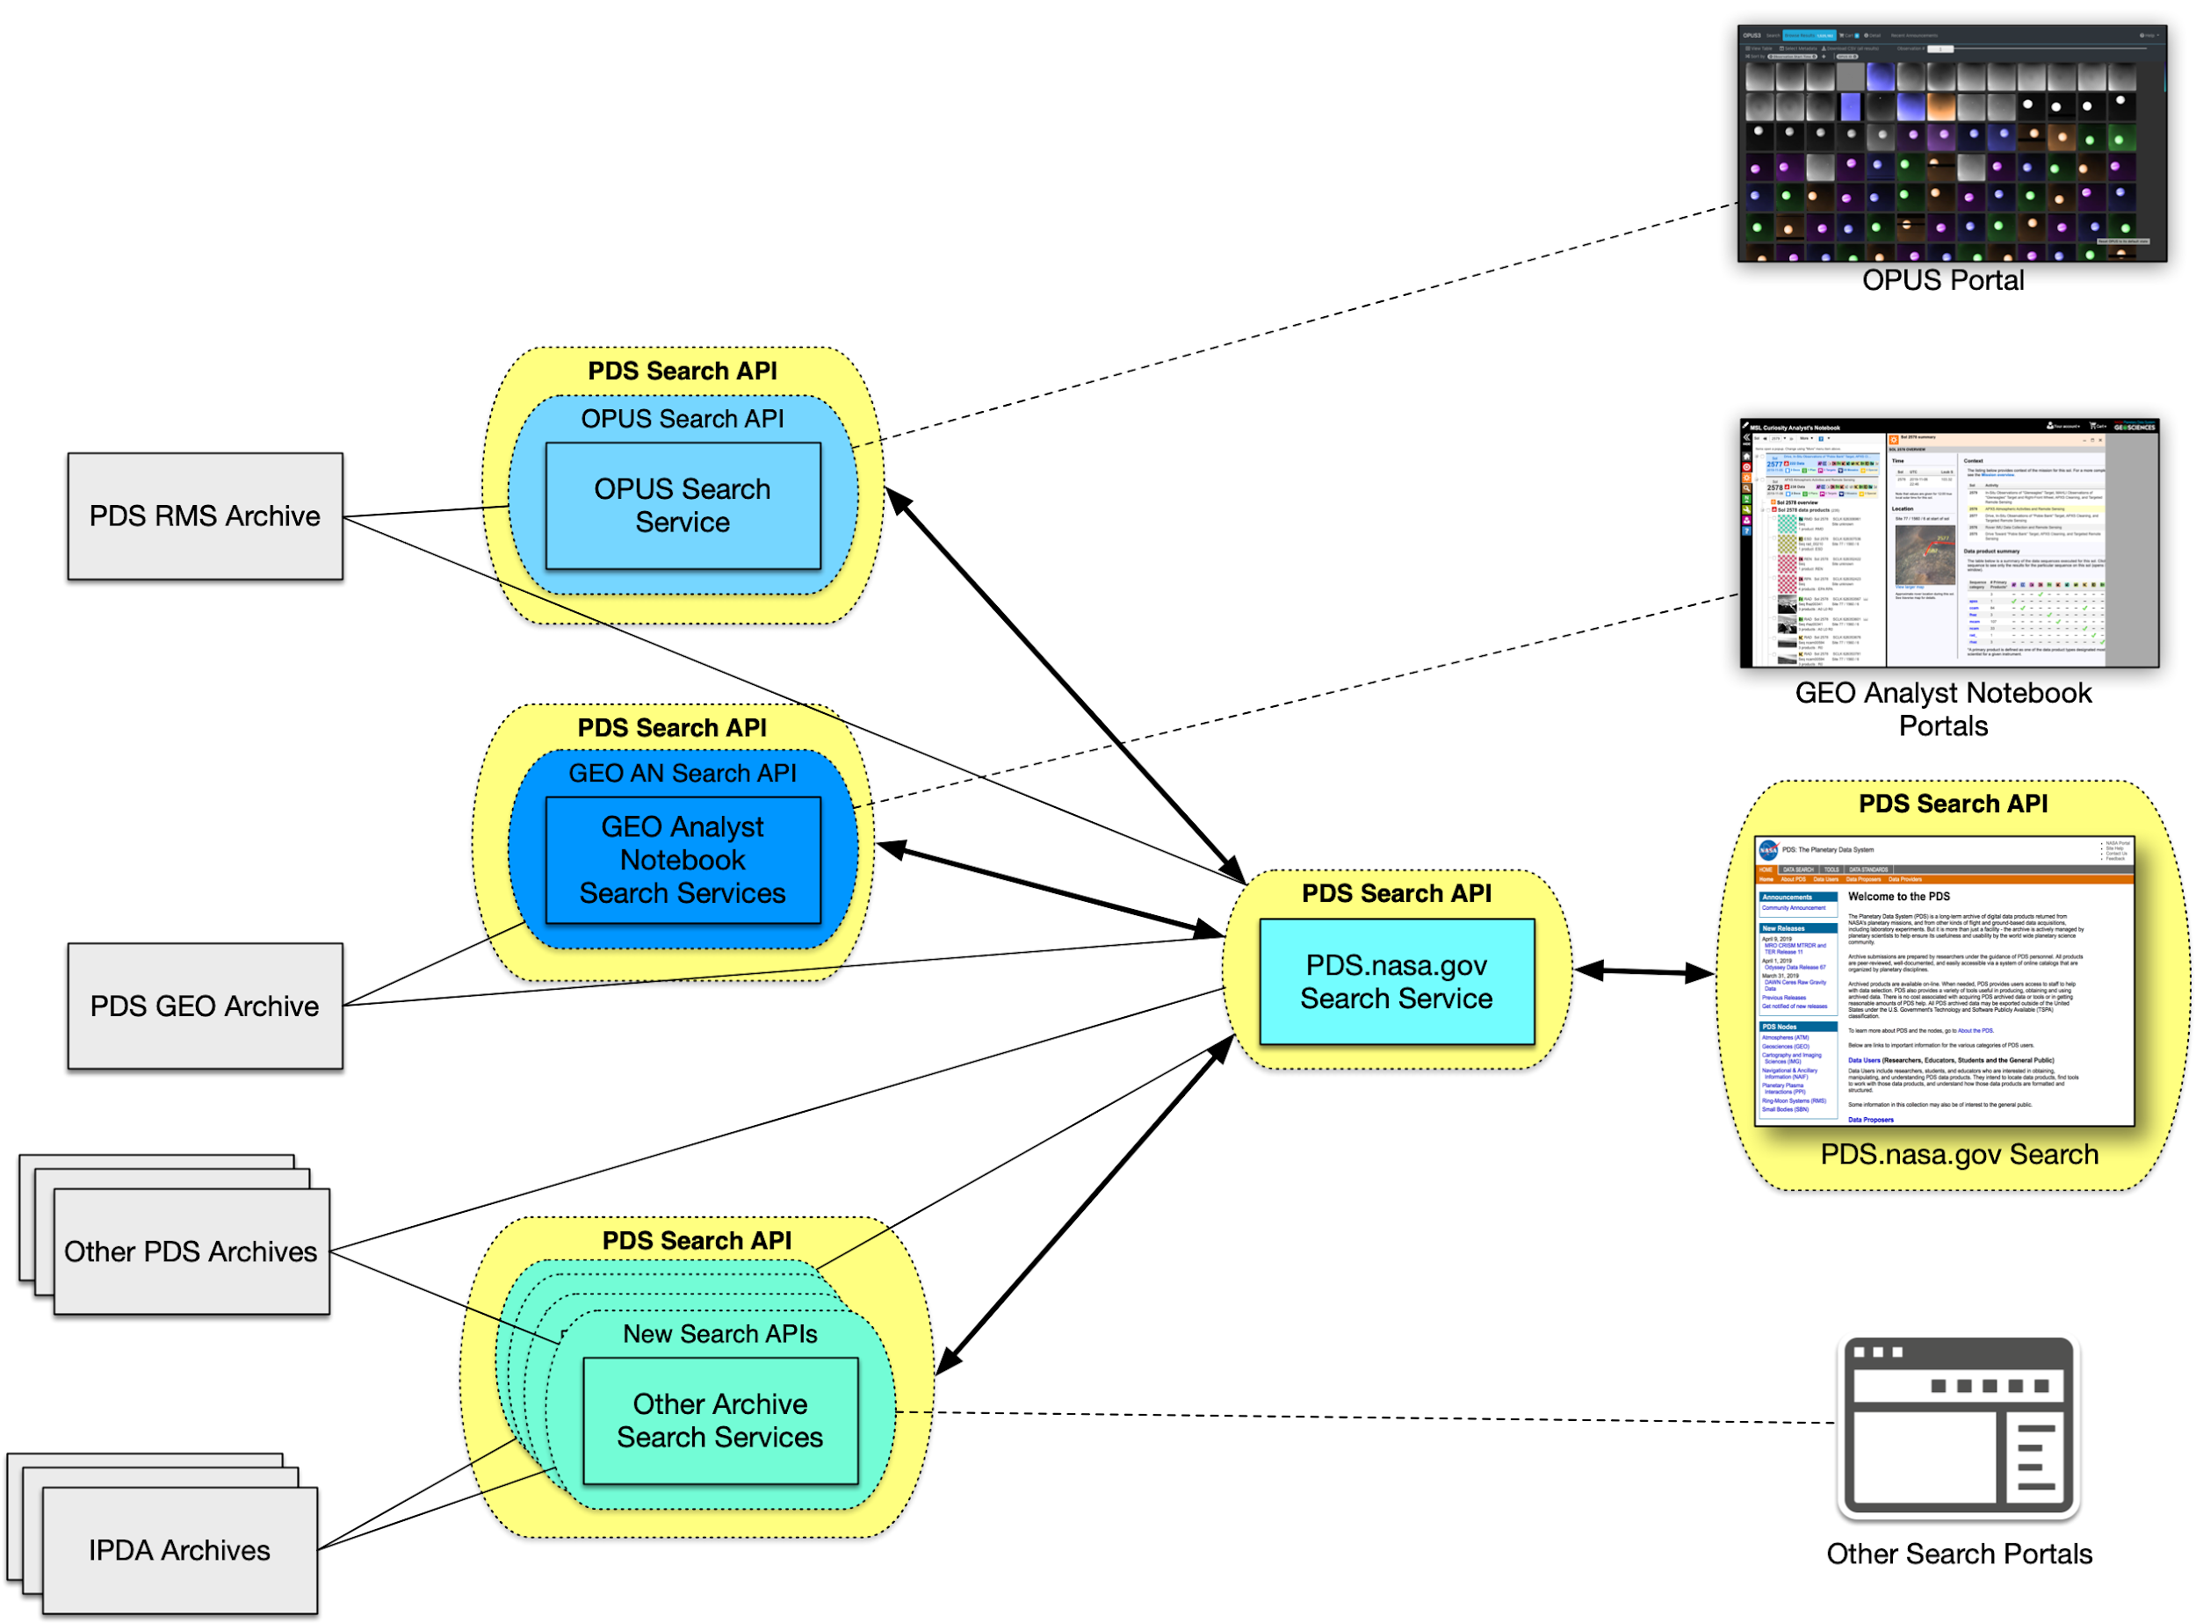
Search Integration with PDS Search API:
Integrate EN Search with Discipline Node Search

Slide 19
Search Integration with PDS Search API:
Integrate EN Search with Discipline Node Search

Slide 20
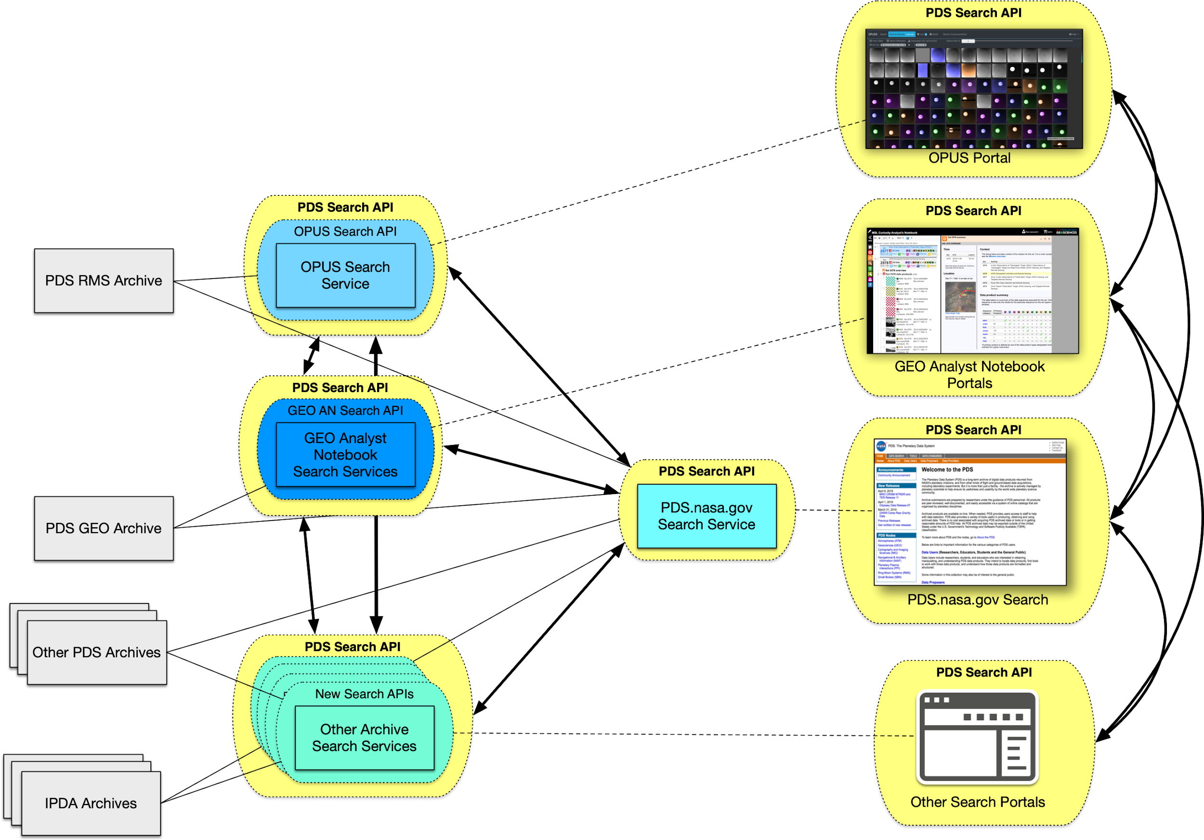
Search Integration with PDS Search API:
Integrate All PDS Searches
1 Highway (PDS API)*,
consistent signs,
consistent directions.
*or several highways that merge with one another seamlessly...

Slide 21
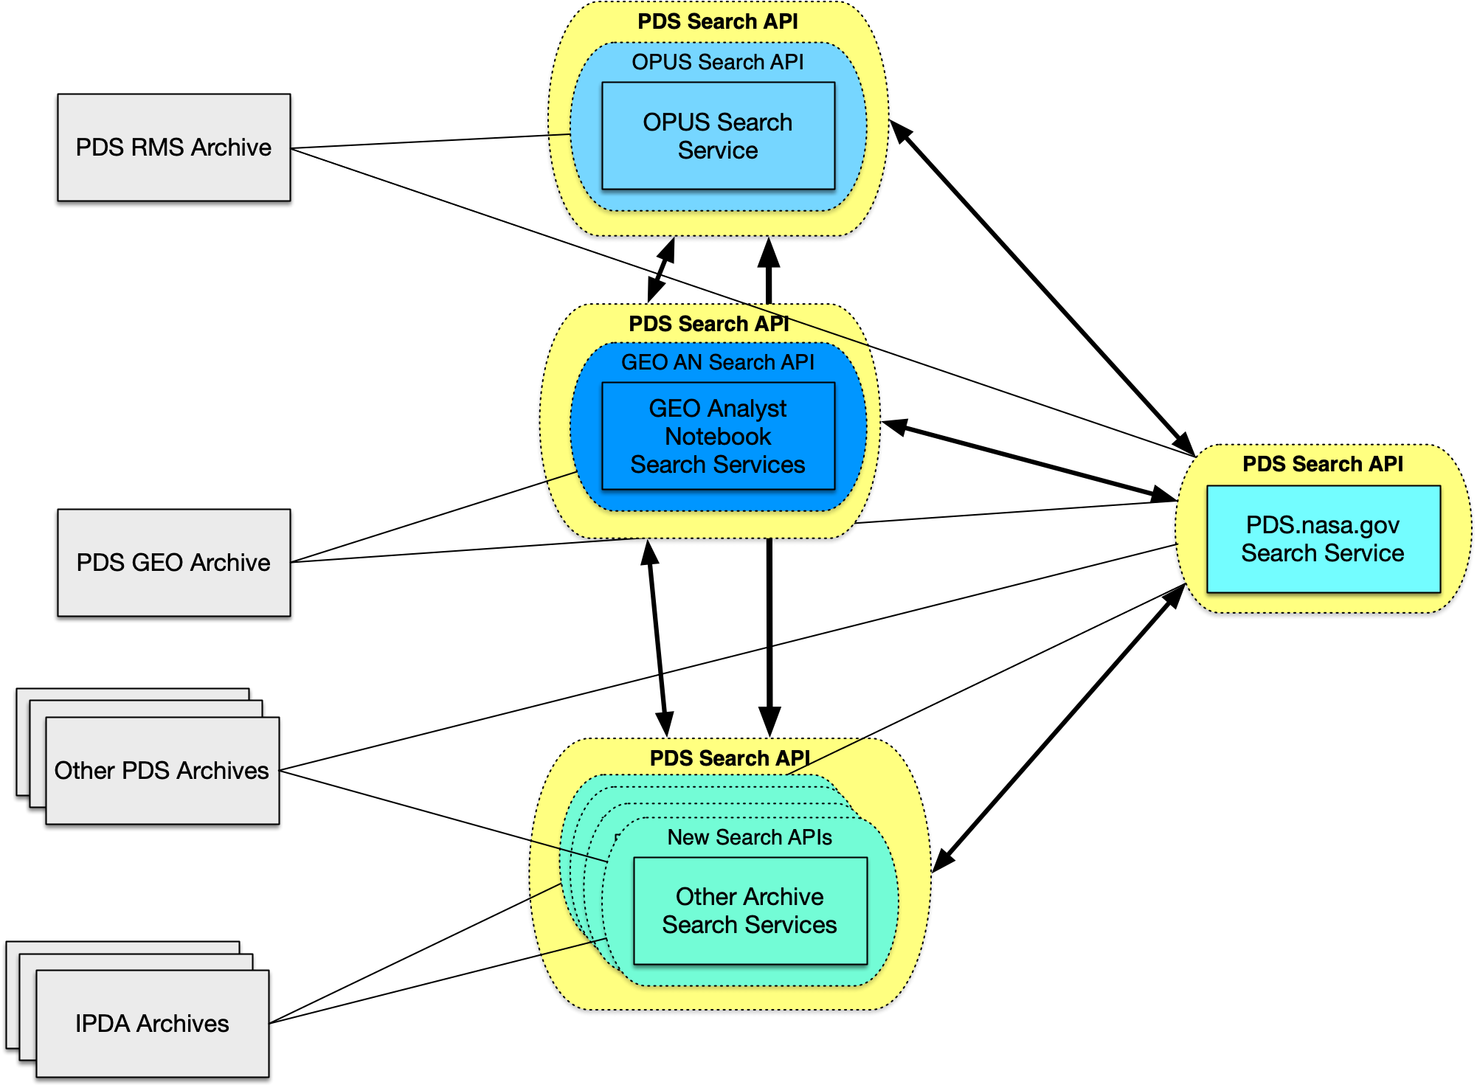

Hi! I’m a PlanetaryPy developer and I want to create a tool that includes searching for PDS data.

Slide 22
Hi! I’m a PlanetaryPy developer and I want to create a tool that includes searching for PDS data.
pds.search(“investigation_ref=urn:nasa:pds:context:investigation:mission.insight”)
(notional. do not try in the wild.)

Slide 23
PDS API Working Group
The PDS API WG provides technical expertise and guidance the PDS MC and international community on the design, development, and implementation of the PDS API Specification.
Charter (Draft): https://docs.google.com/document/d/1I5PrNF_Jv8DQiaNvo0O0ogBCF0WMAaV9yOfGx2Y_f0M/edit#heading=h.2et92p0
PDS API Spec:
Released (v0.0.1-alpha): https://github.com/NASA-PDS/pds-api/blob/master/docs/spec/pds-api-specification.md
In Development: https://docs.google.com/document/d/16d0MVh48bFLvWsa5-B_Hy-cby1rGWdnNojWOJpUcOvA/edit?usp=sharing
Notes:
Group to drive the development of the specification

Slide 24
PDS API Working Group Members
Mcclanahan, Timothy (PDS PO)
Lynn Neakrase (ATM)
Ed Guiness (GEO)
Tom Stein (GEO)
Dan Scholes (GEO)
Sebastien Besse (ESA)
Myche McAuley (IMG)
Rishi Verma (IMG)
In Sook Moon (PPI)
Rob French (RMS)
Matt Tiscareno (RMS)
Conor Kingston (SBN)
David Chang (SBN)
Daniel Darg (SBN)
Emily Law (EN)
Yevgen Karpenko (EN)
Thomas Loubrieu (EN)
Jordan Padams (EN)
Boris Semenov (NAIF)

Slide 25
API Goals and Plan
Ambition:
Build a layer which will allow users/systems to explore/use PDS’s resources seamlessly,
In other words build the highways to drive users to data in nodes
Design a PDS-wide web API specification
Initial focus is on search on collections (build 11.1) (in progress)
API should be applicable to other resources (products) and services (view, download, transform, …)
Implements the standard with (build 11.1):
Engineering Node provides libraries, skeleton servers, clients to help with the implementation (done)
Engineering Node provides a standard implementation on top of registry (in progress)
Discipline Nodes (1-2) provide implementation to demonstrate the integration of the API (to be done)

Slide 26
What is a web API request?
Requests:
GET https://pds.nasa.gov/api/products/urn:nasa:pds:orex....1.0
GET https://pds.nasa.gov/api/collections?search=europa
Response:
{
"id": "urn:nasa:pds:orex.ocams:d...824s852_pol_l0pan.fits::1.0",
"class": "Product_Observational",
"title": "OSIRIS-RE... Data Product 2019-07-02T07:28:24.852Z",
"start_date_time": "2019-07-02T07:28:24.852Z",
"stop_date_time": "2019-07-02T07:28:24.852Z",
….
Notes:
easy to use for application client, jupyter notebooks

Slide 27
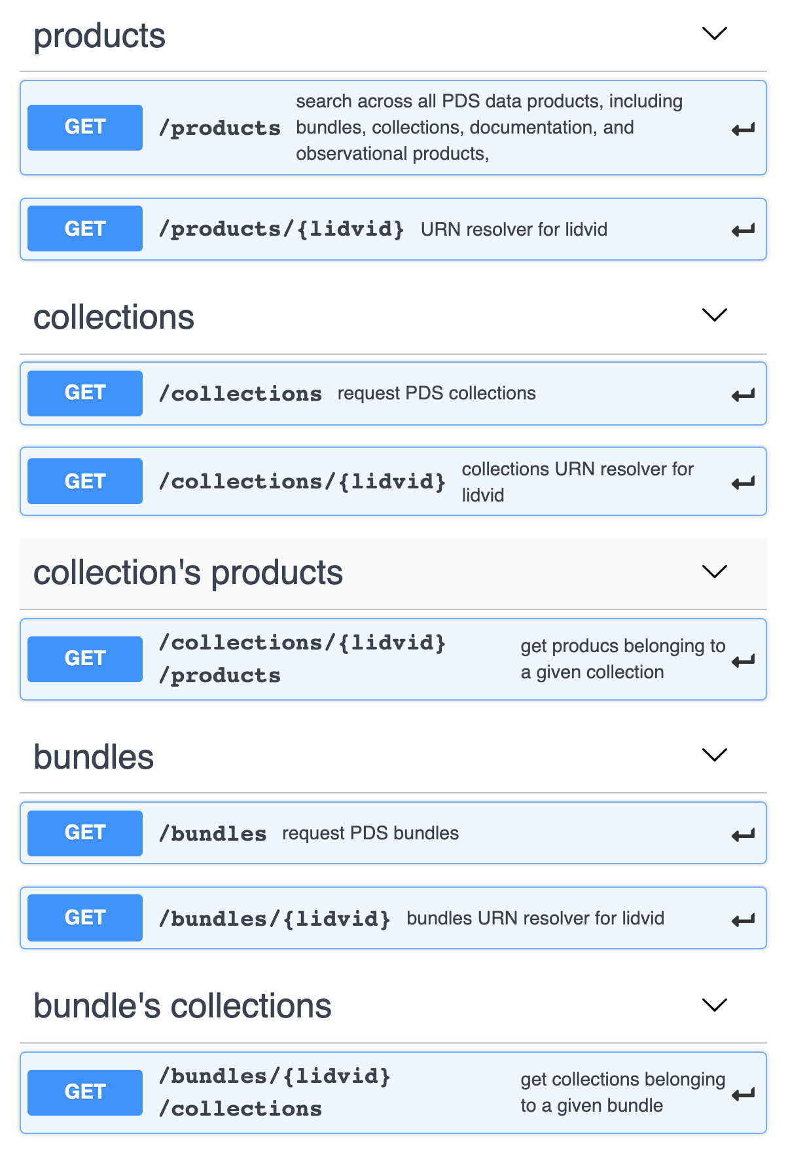
PDS API Specification
PDS API Specification Core Document online:
Released: https://github.com/NASA-PDS/pds-api/blob/master/docs/spec/pds-api-specification.md
In Development: https://docs.google.com/document/d/16d0MVh48bFLvWsa5-B_Hy-cby1rGWdnNojWOJpUcOvA/edit?usp=sharing
Collections/bundles/products end-points
Requests:
livid resolver
or complex search query (eq, lt, le, …, not, and, or)
Responses: XML PDS4 labels or JSON objects
Crawl an archive:
bundle → collections → products
(Swagger online specification design)

Slide 28
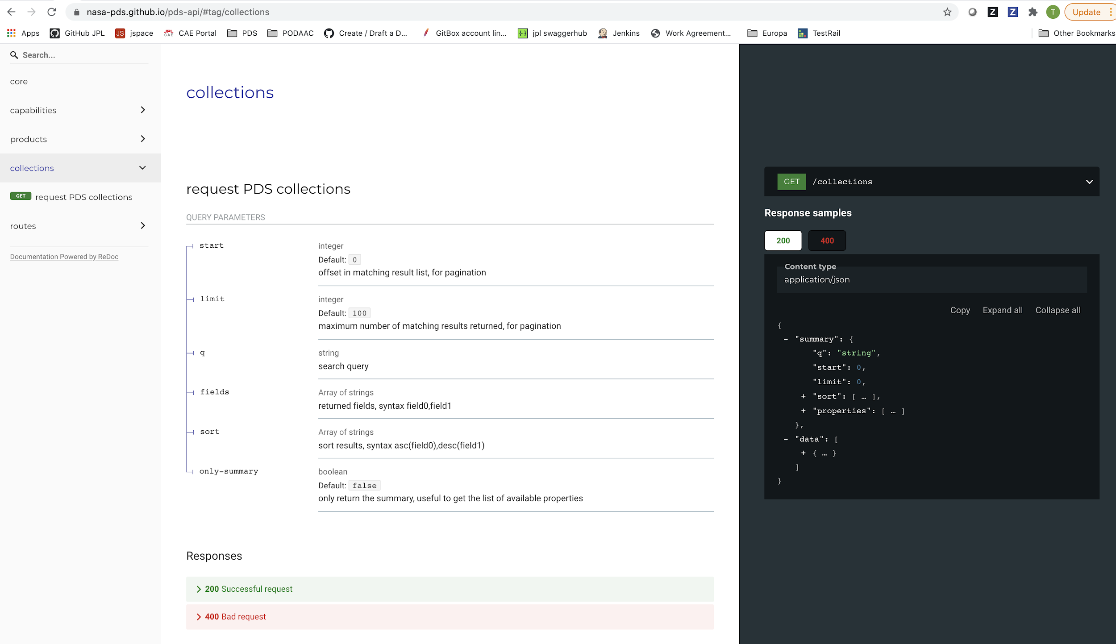
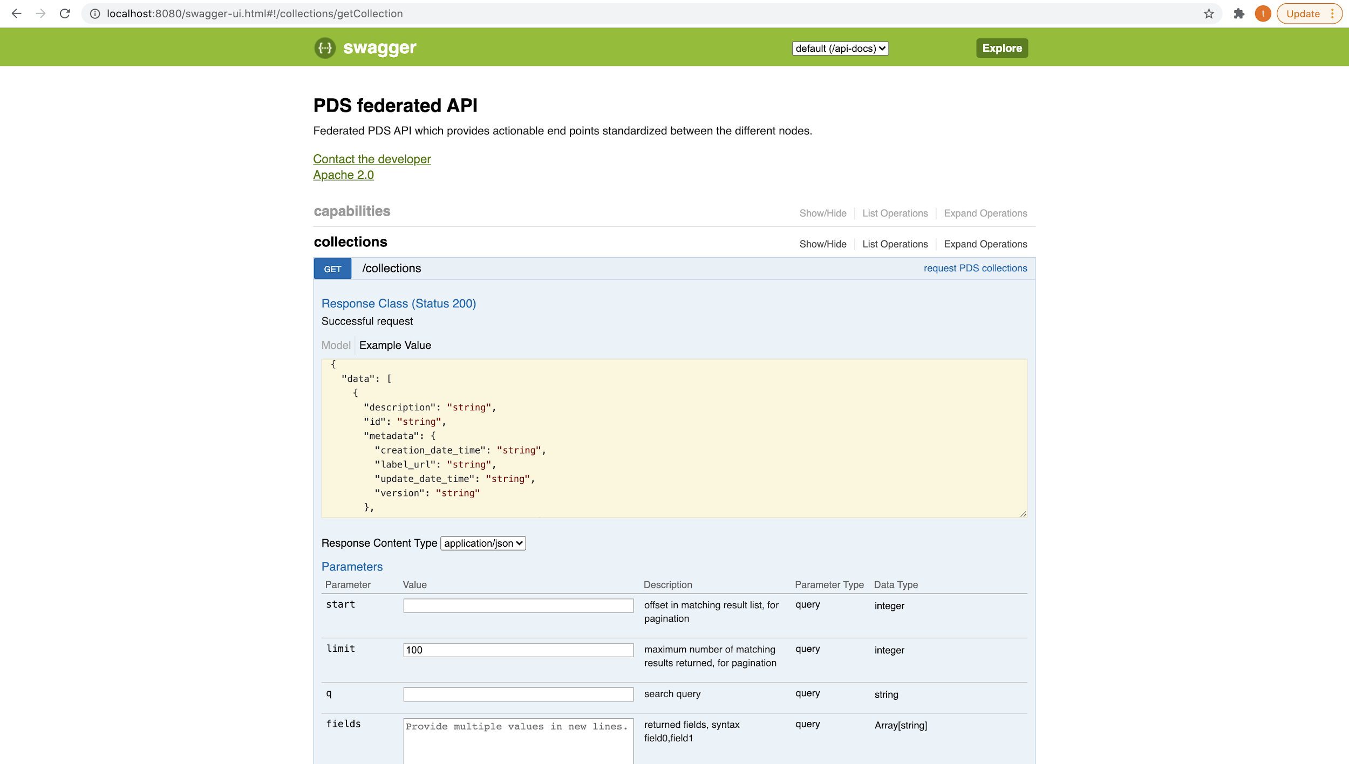
API Implementation
An ecosystem of elementary, reusable components:
Automated documentation: https://nasa-pds.github.io/pds-api/
Test with Postman: https://github.com/NASA-PDS/pds-api#to-generate-a-postman-test-collection
API search query lexer: https://github.com/NASA-PDS/api-search-query-lexer
API data model implementation (java): https://github.com/NASA-PDS/pds-api-javalib
Skeleton server (java): https://github.com/NASA-PDS/pds-api-service
Client (python): https://github.com/NASA-PDS/pds-api-client
Demonstration notebooks: https://github.com/NASA-PDS/pds-api-notebook
Demo server integrated with the registry: https://pds-gamma.jpl.nasa.gov/api/swagger-ui.html
ONLINE
DOC
DEMO
SERVER
Notes:
ONLINE
DOC

Slide 29
Coming Soon

Slide 30
Near Term (~October 2021)
Performance improvements
Ingest more PDS4 data
Continued development of Jupyter notebooks
Community input welcome!
Pilot integration with discipline node search engines
Support PDS3 and “supplemental metadata”
Extend the API to include units, refine response format
Refine API based upon community feedback!

Slide 31
Longer Term
Develop a web UI using the API
Search integration across the PDS, international partners, and other APIs
Provide pre-defined computing/analysis result (e.g. mean, min/max, other...)
Custom development of tools that can integrate with PDS data across the federation
Development of Jupyter notebooks and other data analysis capabilities
Development of future data services that integrate computing and data
Integrate, integrate, integrate...

Slide 32
Getting Involved
OpenPlanetary Slack - #pds channel
OpenPlanetary Forum - Data Access and Discovery
PDS API Repos
Submit Feature Requests, Bug Reports, etc.
API User Stories
We are looking for real-world stories for how people want to use a PDS API
Submit here: https://pds.nasa.gov/?feedback=true
OR email / Slack Jordan, Thomas, or any API WG member

Slide 33
API Working Artifacts
PDS API Specification Core Document online:
Released: https://github.com/NASA-PDS/pds-api/blob/master/docs/spec/pds-api-specification.md
In Development: https://docs.google.com/document/d/16d0MVh48bFLvWsa5-B_Hy-cby1rGWdnNojWOJpUcOvA/edit?usp=sharing
Automated documentation: https://nasa-pds.github.io/pds-api/
Test with Postman: https://github.com/NASA-PDS/pds-api#to-generate-a-postman-test-collection
API search query lexer: https://github.com/NASA-PDS/api-search-query-lexer
API data model implementation (java): https://github.com/NASA-PDS/pds-api-javalib
Skeleton server (java): https://github.com/NASA-PDS/pds-api-service
Client (python): https://github.com/NASA-PDS/pds-api-client
Demonstration notebooks: https://github.com/NASA-PDS/pds-api-notebook

Slide 34
Demo

Slide 35
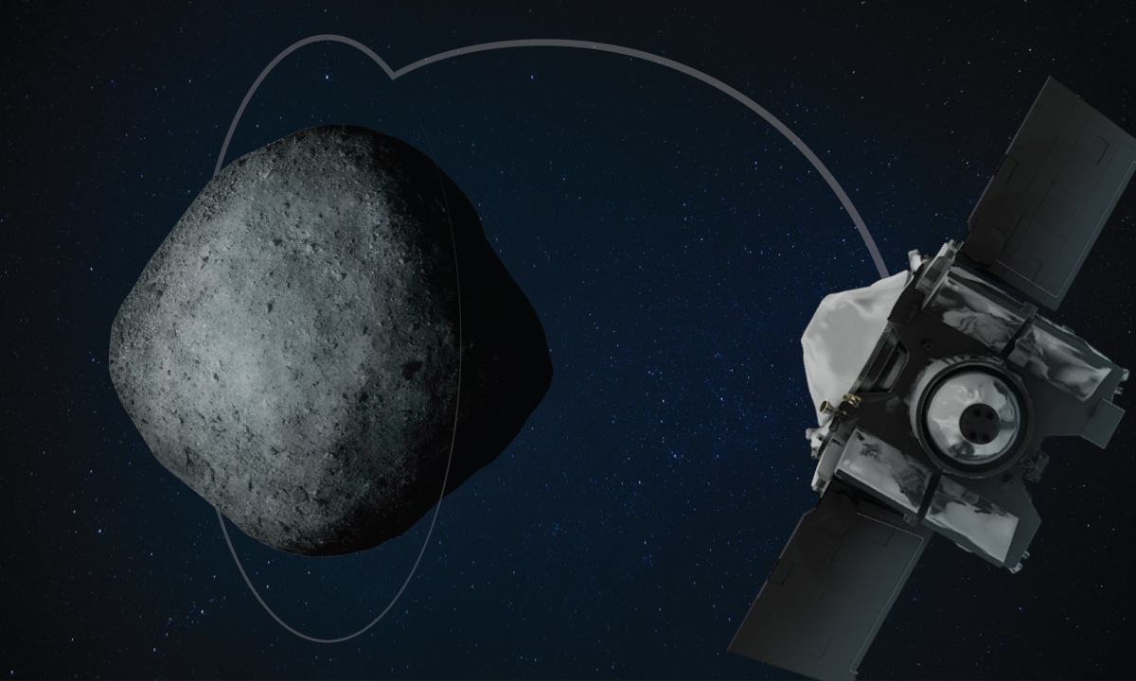
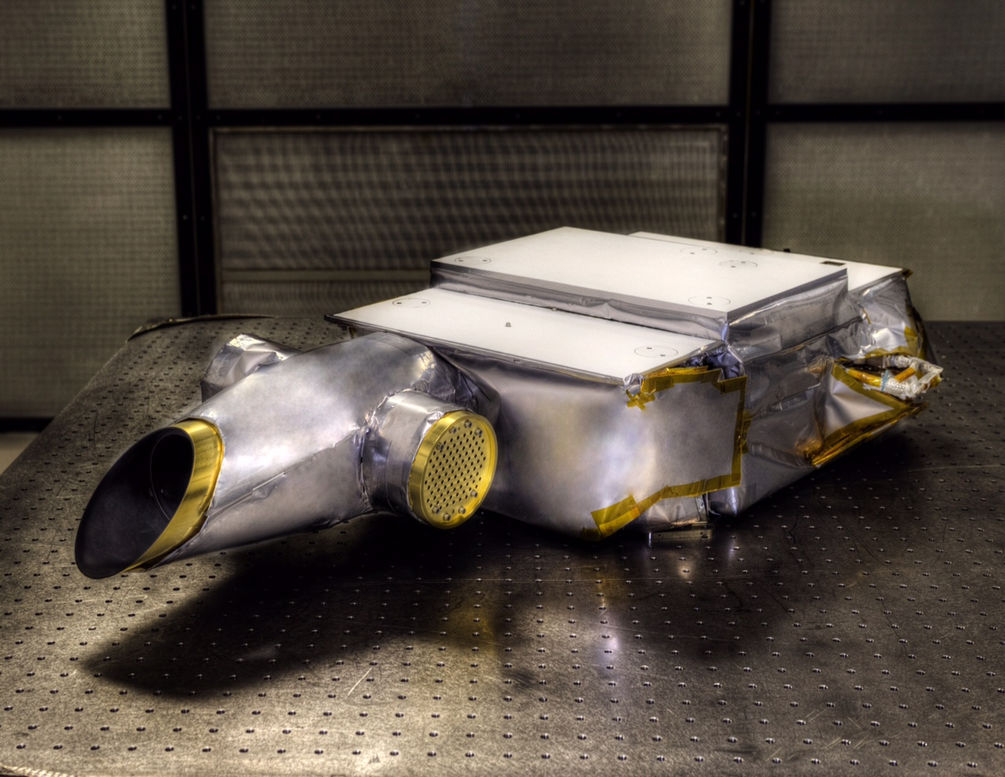
Demo Intro
Osiris-REX Visible and Infrared spectrometer (OVIR) collection:
Part 1: explore the collection
Part2: find and visualize data

Slide 36
Link to demo material
The jupyter notebooks used for the demo are available on:
https://github.com/NASA-PDS/pds-api-notebook

Slide 37
Backup

Slide 38

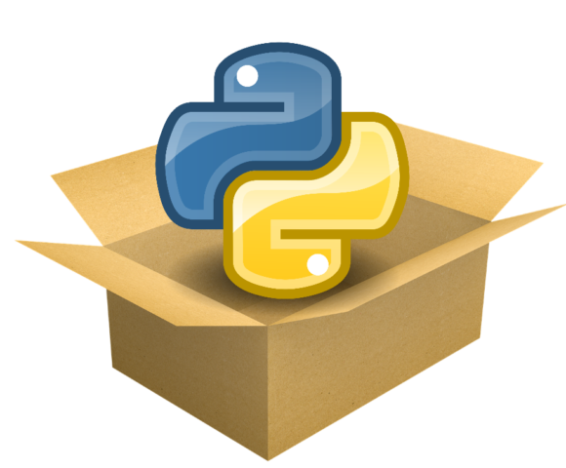



Demo stack
notebook
pds.api-client
(python package)
PDS API Specification
HTTP
PDS API server
PDS4 Archive
(files)
Registry
harvest

Slide 39
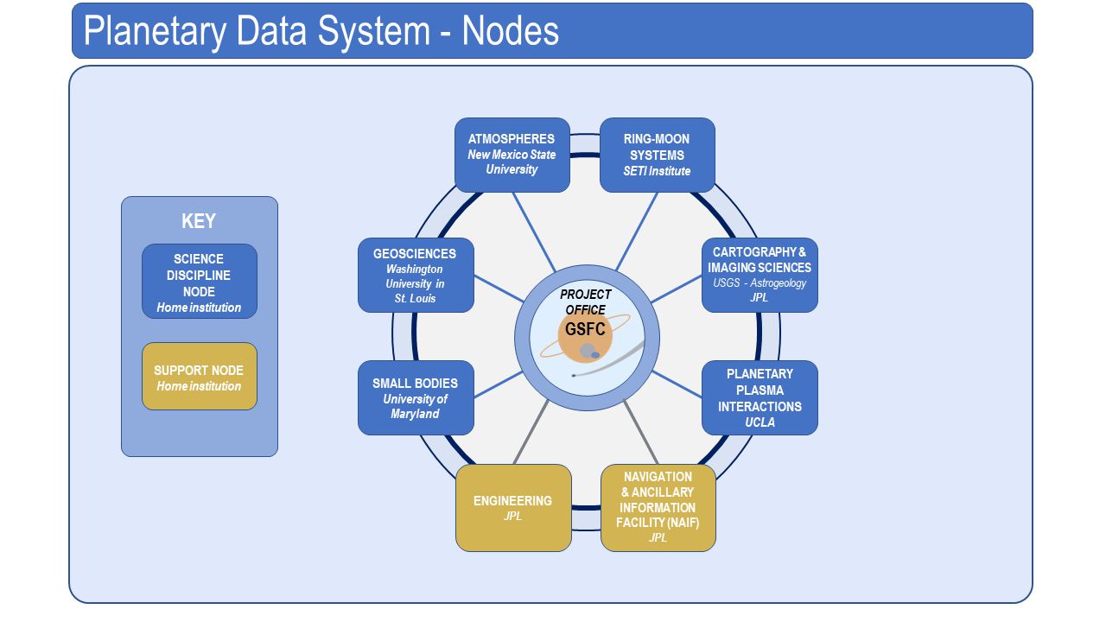
PDS Federated Architecture

Slide 40
PDS Federated Architecture Today
Current State of the PDS: A Stewardship Model
A robust information model (PDS4) and process for archiving and stewarding data.
This is a critical foundation for international discovery and use!
It is the de facto standard world-wide which is a huge opportunity
A multi-level search implementation following a system-of-systems approach
Users can get to the data
We have some great node services
We can link internationally

Slide 41
PDS Federated Architecture Today
Key Challenges
Inconsistency in common protocols/standards around data discovery across PDS and the archive community systems: APIs; linking between search engines
Inconsistent metadata (PDS3); differing use of parameters (PDS3, PDS4, other) for search/query
Adoption of differing search methodologies and technologies (this is a fast moving target)
End-to-end “search chain” and its impact on user interface/user experience (UI/UX)
Lack of explicit, consistent, and sharable web services for sharing PDS data and common functions (”data services”) across the federation
Differing approaches to navigating mission support and data access pages

Slide 42
PDS Roadmap Study (2017) [1]
Highlights Around Data Services
Discoverability - There is a need for PDS to both expand and deepen its search.
Integration with Other Archives – After international adoption of PDS4, the PDS is uniquely poised to lead efforts to make national and global archives interoperable.
Modernizing Metadata – Leveraging PDS4 metadata from stewardship to discovery.
Access Data – Build on PDS4 successes to continue to increase access to data.
Transformation – Increase support for translation services to deliver data in different formats.
Information Technology – Ensure PDS continues to leverage modern technology approaches in search and data analytic support.
Transparency - Provide documented APIs for open access to data and services.
[1] https://pds.nasa.gov/home/about/PlanetaryDataSystemRMS17-26_20jun17.pdf

